Slide 1
FINAL PROJECT ON CUSTOMER SEGMENTATION
Instructor Presented By
Dr. Chaojiang (CJ) Wu, Ph.D. Pravalika Girneni
Fundamentals Of Machine Learning pgirneni@kent.edu
MIS-64060-003

Slide 2

Problem statement:
Here we are taking the topic of customer segmentation. I wanted to specifically focus on the annual income of the customers in correlation to their annual spending score. These two segments were chosen as the focal point for my final project because I wanted to address the problem of annual incomes accurately reflecting an individual’s spending score. This was the problem statement that I decided to focus on because I intended to show that the annual incomes of an individual are not necessarily a predictor of annual spending scores.
Source of dataset: https://www.kaggle.com/code/naren3256/kmeans-clustering-and-cluster-visualization-in-3d/data

Slide 3
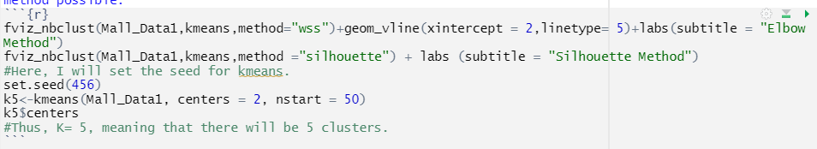
Approach and algorithm
Here we have used k-means, Elbow method, Silhouette method
K-mean/unsupervised learning: K-Means is the most popular clustering algorithm. It uses an iterative technique to group unlabeled data into K clusters based on cluster centers (centroids). The data in each cluster are chosen such that their average distance to their respective centroid is minimized.
Elbow Method: In cluster analysis, the elbow method is a heuristic used in determining the number of clusters in a data set. The method consists of plotting the explained variation as a function of the number of clusters and picking the elbow of the curve as the number of clusters to use.
Silhouette method: computes silhouette coefficients of each point that measure how much a point is similar to its own cluster compared to other clusters. by providing a succinct graphical representation of how well each object has been classified.

Slide 4
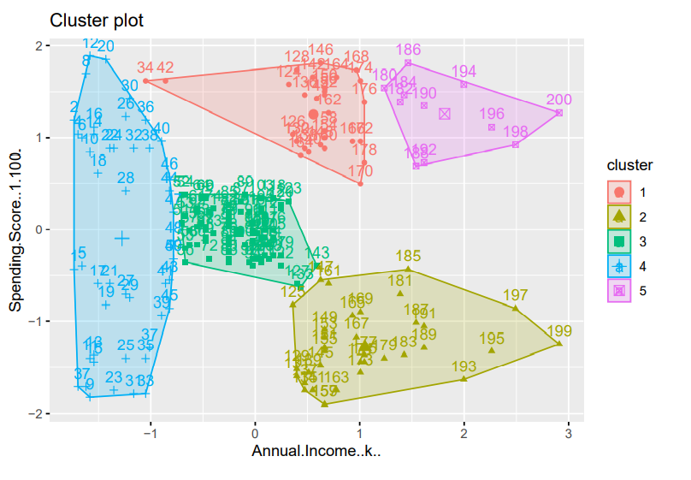
Result
Cluster 1: Mall_Datacustomer who earn a medium annual income and have a medium annual spending rate.
Cluster 2:Mall_Datacustomer who have a high annual income and a low annual spending rate.
Cluster 3:costumers who have low annual incomes and a high annual spending rates.
Cluster 4:Mall_Datacustomer with high annual incomes and have high annual spending rates.
Cluster 5:shows that Mall_Datacustomer with low annual incomes and low annual spending rates.

Slide 5
Thank you

